Slide 1
Classical Object Detection

Slide 2
Outline
Classical Object Detection vs. Modern Object Detection
Classical Object Detection approaches
Object detection by classification
Sliding window based object detection

Slide 3
Classical Object detection vs. Modern object detection
In classical object detection approaches, feature-based methods play a critical role.
They rely heavily on
hand-engineered features (like HOG, SIFT, or Haar features) and
traditional machine learning algorithms (like SVM or AdaBoost).
The process often involves separate stages for feature extraction, object localization (e.g., sliding windows), and classification.

Slide 4
Classical Object detection vs. Modern object detection
Modern object detection approaches use deep learning models, particularly Convolutional Neural Networks (CNNs), to automatically learn feature representations from data without manual intervention.
These approaches often integrate object localization and classification into a single end-to-end trainable model, such as with Faster R-CNN, YOLO (You Only Look Once), or SSD (Single Shot Multibox Detector).

Slide 5
Classical Object Detection approaches
Object detection by classification
Sliding window based object detection

Slide 6
Object detection by classification
These approaches rely on extracting distinctive and informative features from images to train classifiers that can recognize objects within new images.
In its basic form, this approach focuses on determining whether an object (or objects) of interest is present in an image, often without specifying the location.
It's similar in concept to image classification but focused on specific objects.
Important design considerations in this approach are the choice of features (feature extraction techniques) and classifier used for object detection.

Slide 7
Object detection by classification – Typical workflow
Required Inputs:
Training Data: A set of labeled images where the presence or absence of objects of interest is marked.
Feature Extractor: A method to extract relevant features from images (e.g., HOG, SIFT, SURF).
Classifier: A machine learning model to classify images as containing the object or not (e.g., SVM, Random Forest).
Training Phase:
Feature Extraction:
Extract features from the entire image, both from images with objects (positive samples) and without objects (negative samples).
Train Classifier:
Use the extracted features to train the classifier to distinguish between images that contain objects and those that do not.
Testing/Detection Phase:
Feature Extraction on New Image:
For each new image, extract features using the same method employed during training.
Classification:
Use the trained classifier to predict whether the entire image contains the object.
Output:
The classifier provides a binary output indicating the presence or absence of the object in the image, without specifying the object's location.

Slide 8
Object detection by classification
Example Features: HOG (Histogram of Oriented Gradients):
HOG involves dividing an image into small connected regions called cells, and for each cell, accumulating a histogram of gradient directions (or edge orientations) for the pixels within the cell.
HOG features are famously used in pedestrian detection systems because human forms typically have distinct edge structures that are well-captured by gradient histograms.

Slide 9
Object detection by classification – example code
import numpy as np
import matplotlib.pyplot as plt
from skimage.io import imread
from skimage.transform import resize
from skimage.feature import hog
from skimage import exposure
from sklearn.model_selection import train_test_split
from sklearn.svm import LinearSVC
from sklearn.metrics import accuracy_score, classification_report

Slide 10
Object detection by classification – example code
# Load your dataset
# For the demo, we assume `positive_images` and `negative_images` are lists of image file paths.
def load_images(image_files):
images = [imread(file) for file in image_files]
images = [resize(image, (128, 64)) for image in images] # Resize images to a consistent size
return images
def extract_features(images):
hog_features = []
for image in images:
fd, hog_image = hog(image, orientations=9, pixels_per_cell=(8, 8),
cells_per_block=(2, 2), visualize=True, multichannel=True)
hog_features.append(fd)
return hog_features

Slide 11
Object detection by classification – example code
# Example data loading
# positive_images = load_images(['path/to/pos1.jpg', 'path/to/pos2.jpg', ...])
# negative_images = load_images(['path/to/neg1.jpg', 'path/to/neg2.jpg', ...])
# Assume images are loaded into positive_images and negative_images as lists of numpy arrays
# Extract features
positive_features = extract_features(positive_images)
negative_features = extract_features(negative_images)
# Create labels
labels = np.array([1] * len(positive_features) + [0] * len(negative_features))
features = np.array(positive_features + negative_features)
# Split data into training and testing sets
X_train, X_test, y_train, y_test = train_test_split(features, labels, test_size=0.2, random_state=42)

Slide 12
Object detection by classification – example code
# Train a classifier
clf = LinearSVC()
clf.fit(X_train, y_train)
# Test the classifier
y_pred = clf.predict(X_test)
print("Classification report:")
print(classification_report(y_test, y_pred))
# Function to test new images using the trained classifier
def detect_object(img, clf, threshold=0.5):
img_resized = resize(img, (128, 64)) # Resize the image to the same size as training data
fd, _ = hog(img_resized, orientations=9, pixels_per_cell=(8, 8),
cells_per_block=(2, 2), visualize=True, multichannel=True)
pred = clf.decision_function([fd])
if pred > threshold:
return "Object detected"
else:
return "No object detected"

Slide 13
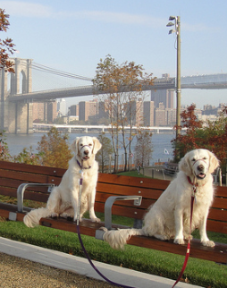
Object detection by classification – example code
# Example usage:
# test_img = imread('path/to/test_image.jpg')
# result = detect_object(test_img, clf)
# print(result)
Object detected
Object not detected

Slide 14
Sliding window based object detection
In the sliding window technique, a window of a fixed size moves across the image at all positions and scales.
At each position, the features within the window are extracted and fed into a classifier to determine whether an object is present.

Slide 15
Sliding window based object detection
This not only detects the object in an input image, but also provides its location as specified by the sliding window coordinates for the object is detected.
Thus, this approach is a simple extension to the previous approach, as it simply applied ‘object detection by classification’ to each sliding window.

Slide 16
Sliding window method - dealing with scale

Slide 17
Sliding window method - dealing with scale
Use same window size, but run on image pyramid

Slide 18
Sliding Window Technique Workflow
Required Inputs:
Training Data: A set of labeled images where objects of interest are marked.
Feature Extractor: A method to extract relevant features from images (e.g., HOG, Haar).
Classifier: A machine learning model to classify regions as containing the object or not (e.g., SVM, AdaBoost).
Training Phase:
Feature Extraction:
Extract features from labeled regions of interest (positive samples) and regions without objects (negative samples) using the chosen feature extractor.
Train Classifier:
Use the extracted features to train the classifier to distinguish between positive and negative examples.
Testing/Detection Phase:
Feature Extraction on New Image:
Apply the sliding window across the entire image at multiple scales and locations.
Extract features from each window using the same method used during training.
Classification:
Use the trained classifier to predict whether each window contains the object.

Slide 19
Sliding window method - example
Example: A common example is face detection, where a sliding window moves across the image, and at each step,
HOG or Haar features are extracted and
evaluated by an SVM or AdaBoost classifier to determine whether a face is present in the window.

Slide 20
Sliding Window Method – example code
import numpy as np
import matplotlib.pyplot as plt
from skimage.io import imread
from skimage.transform import resize
from skimage.feature import hog
from skimage import exposure
from sklearn.model_selection import train_test_split
from sklearn.svm import LinearSVC
from sklearn.metrics import accuracy_score, classification_report
# Define the sliding window function
def sliding_window(image, step_size, window_size):
"""Slide a window across the image"""
for y in range(0, image.shape[0] - window_size[1], step_size):
for x in range(0, image.shape[1] - window_size[0], step_size):
# yield the current window
yield (x, y, image[y:y + window_size[1], x:x + window_size[0]])

Slide 21
Sliding Window Method – example code
# Function to detect objects in an image using sliding windows
def detect_objects(image, clf, window_size=(128, 64), step_size=32):
scale = 0
detections = []
resized_img = image
# Loop over the sliding window for each layer of the pyramid
for (x, y, window) in sliding_window(resized_img, step_size=step_size, window_size=window_size):
# If the window does not meet our desired window size, ignore it
if window.shape[0] != window_size[1] or window.shape[1] != window_size[0]:
continue
# Extract HOG features from the window captured
fd, hog_image = hog(window, orientations=9, pixels_per_cell=(8, 8),
cells_per_block=(2, 2), visualize=True, multichannel=True)
fd = fd.reshape(1, -1)
pred = clf.predict(fd)
# Check to see if our classifier predicts an object
if pred == 1:
detections.append((x, y, clf.decision_function(fd), scale))
# Rescale image for next iteration to form an image pyramid
scale += 1
return detections

Slide 22
Sliding Window Method – example code
# Example of using detect_objects function
# Load an image, run the detection
test_img = imread('path/to/test_image.jpg')
detected_objects = detect_objects(test_img, clf)
# Visualize the detections
fig, ax = plt.subplots(figsize=(10, 6))
ax.imshow(test_img)
for (x, y, _, scale) in detected_objects:
# draw bounding boxes
rect = plt.Rectangle((x, y), 128, 64, linewidth=1, edgecolor='r', facecolor='none')
ax.add_patch(rect)
plt.show()

Slide 23
Classical Object Detection approaches
Integral images for rapid Feature evaluation
Viola-Jones framework for face detection
Deformable part models
Continued…

Slide 24
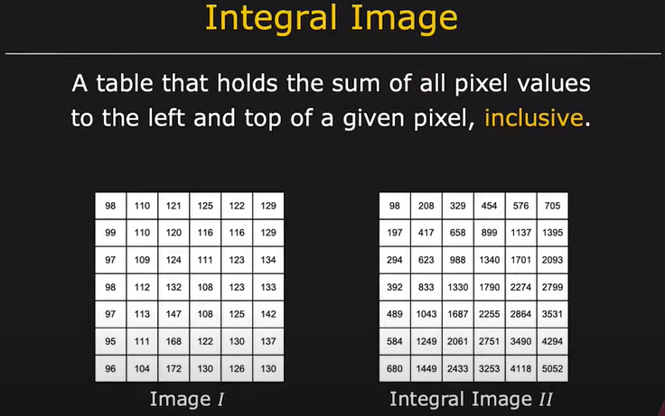

Slide 25
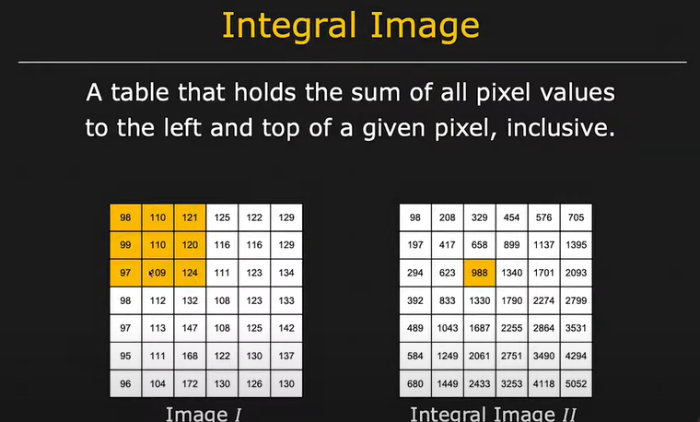

Slide 26
Find integral image for stereo image of given input.
4 | 5 | 2 | 1
0 | 9 | 3 | 2
5 | 6 | 8 | 1
2 | 3 | 0 | 0

Slide 27
Solutions
Input
Output
4 | 5 | 2 | 1
0 | 9 | 3 | 2
5 | 6 | 8 | 1
2 | 3 | 0 | 0

Slide 28
Input
Output
4 | 5 | 2 | 1
0 | 9 | 3 | 2
5 | 6 | 8 | 1
2 | 3 | 0 | 0
4

Slide 29
Input
Output
4 | 5 | 2 | 1
0 | 9 | 3 | 2
5 | 6 | 8 | 1
2 | 3 | 0 | 0
4 | 9

Slide 30
Input
Output
4 | 5 | 2 | 1
0 | 9 | 3 | 2
5 | 6 | 8 | 1
2 | 3 | 0 | 0
4 | 9 | 11

Slide 31
Input
Output
4 | 5 | 2 | 1
0 | 9 | 3 | 2
5 | 6 | 8 | 1
2 | 3 | 0 | 0
4 | 9 | 11 | 12

Slide 32
Input
Output
4 | 5 | 2 | 1
0 | 9 | 3 | 2
5 | 6 | 8 | 1
2 | 3 | 0 | 0
4 | 9 | 11 | 12
4

Slide 33
Input
Output
4 | 5 | 2 | 1
0 | 9 | 3 | 2
5 | 6 | 8 | 1
2 | 3 | 0 | 0
4 | 9 | 11 | 12
4
9

Slide 34
Input
Output
4 | 5 | 2 | 1
0 | 9 | 3 | 2
5 | 6 | 8 | 1
2 | 3 | 0 | 0
4 | 9 | 11 | 12
4
9
11

Slide 35
Input
Output
4 | 5 | 2 | 1
0 | 9 | 3 | 2
5 | 6 | 8 | 1
2 | 3 | 0 | 0
4 | 9 | 11 | 12
4 | 18
9
11

Slide 36
Input
Output
4 | 5 | 2 | 1
0 | 9 | 3 | 2
5 | 6 | 8 | 1
2 | 3 | 0 | 0
4 | 9 | 11 | 12
4 | 18 | 23
9
11

Slide 37
Input
Output
4 | 5 | 2 | 1
0 | 9 | 3 | 2
5 | 6 | 8 | 1
2 | 3 | 0 | 0
4 | 9 | 11 | 12
4 | 18 | 23 | 26
9
11

Slide 38
Input
Output
4 | 5 | 2 | 1
0 | 9 | 3 | 2
5 | 6 | 8 | 1
2 | 3 | 0 | 0
4 | 9 | 11 | 12
4 | 18 | 23 | 26
9 | 29
11

Slide 39
Input
Output
4 | 5 | 2 | 1
0 | 9 | 3 | 2
5 | 6 | 8 | 1
2 | 3 | 0 | 0
4 | 9 | 11 | 12
4 | 18 | 23 | 26
9 | 29
11 | 34

Slide 40
Input
Output
4 | 5 | 2 | 1
0 | 9 | 3 | 2
5 | 6 | 8 | 1
2 | 3 | 0 | 0
4 | 9 | 11 | 12
4 | 18 | 23 | 26
9 | 29 | 42
11 | 34

Slide 41
Input
Output
4 | 5 | 2 | 1
0 | 9 | 3 | 2
5 | 6 | 8 | 1
2 | 3 | 0 | 0
4 | 9 | 11 | 12
4 | 18 | 23 | 26
9 | 29 | 42 | 46
11 | 34

Slide 42
Input
Output
4 | 5 | 2 | 1
0 | 9 | 3 | 2
5 | 6 | 8 | 1
2 | 3 | 0 | 0
4 | 9 | 11 | 12
4 | 18 | 23 | 26
9 | 29 | 42 | 46
11 | 34 | 47

Slide 43
Input
Output
4 | 5 | 2 | 1
0 | 9 | 3 | 2
5 | 6 | 8 | 1
2 | 3 | 0 | 0
4 | 9 | 11 | 12
4 | 18 | 23 | 26
9 | 29 | 42 | 46
11 | 34 | 47 | 51

